Slide 1
How to work with windows and pixels
WHAT DID WE LEARN AT THE SECOND WEEK
PRESENTED BY LILLA TÓTH

Slide 2

Introduction
L
Workexperiences
  Project manager
  Financial assistant
Hobbys and dreams
  Reading, series, garden, turtles
toth.lilla88@gmail.com

Slide 3
Second week tasks
Data structures
Pointers
File manipulations
Drawing with SDL

Slide 4
Week 2 – Day 4
Checker board project
A GOOD SOLUTION

Slide 5
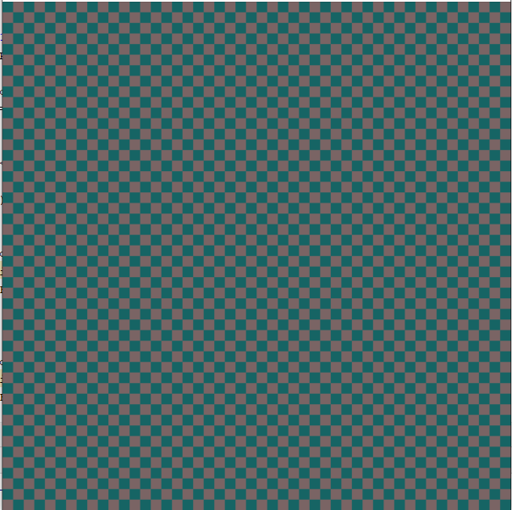
A good solution

Slide 6
Week 2 – Day 4
Checker board
A BAD SOLUTION
BUT I LOVE IT ☺

Slide 7
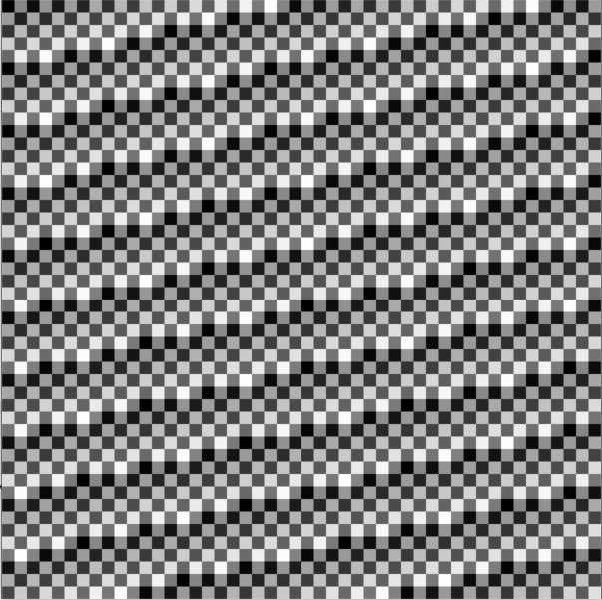
One of Lilla’s bad solutions

Slide 8
The good-bad code: in void draw() function
int red, green, blue;
int x = 0;
int y = 0;
int size = 10;
for (int i = 0; i < SCREEN_HEIGHT / size; ++i) {
red += 122;
green += 122;
blue += 122;
SDL_SetRenderDrawColor(gRenderer, red, green, blue, 0xFF);
SDL_Rect fillRect = {x, y, 10, 10};
SDL_RenderFillRect(gRenderer, &fillRect);
for (int j = 0; j < SCREEN_WIDTH / size; j++) {
red -= 122;
green -= 122;
blue -= 122;
SDL_SetRenderDrawColor(gRenderer, red, green, blue, 0xFF);
SDL_Rect fillRect = {x, y, size, size};
SDL_RenderFillRect(gRenderer, &fillRect);
x += size;
}
x = 0;
y += size;
}

Slide 9
The good-bad code: in void draw() function
Declare basic variables before loops:
int red, green, blue;
Declare and initialize basic variables before loops :
int x = 0;
int y = 0;
int size = 10;

Slide 10
The good-bad code: in void draw() function
For loop and nested for loop:
for (int i = 0; i < SCREEN_HEIGHT / size; ++i) {
red += 122;
green += 122;
blue += 122;
SDL_SetRenderDrawColor(gRenderer, red, green, blue, 0xFF);
SDL_Rect fillRect = {x, y, size, size};
SDL_RenderFillRect(gRenderer, &fillRect);
for (int j = 0; j < SCREEN_WIDTH / size; j++) {
red -= 122;
green -= 122;
blue -= 122;
SDL_SetRenderDrawColor(gRenderer, red, green, blue, 0xFF);
SDL_Rect fillRect = {x, y, size, size};
SDL_RenderFillRect(gRenderer, &fillRect);
x += size;
}
x = 0;
y += size;
}

Slide 11
The good-bad code: in void draw() function
How to determinate the number of the loops?
for (int i = 0; i < SCREEN_HEIGHT / size; ++i) {
for (int j = 0; j < SCREEN_WIDTH / size; j++) {
}
}
We use global variables:
#include <iostream>
#include <SDL.h>
#include <ctime>
//Screen dimension constants
const int SCREEN_WIDTH = 480;
const int SCREEN_HEIGHT = 480;

Slide 12
The good-bad code: in void draw() function
For loop and nested for loop:
for (int i = 0; i < SCREEN_HEIGHT / size; ++i) {
red += 122;
green += 122;
blue += 122;
SDL_SetRenderDrawColor(gRenderer, red, green, blue, 0xFF);
SDL_Rect fillRect = {x, y, size, size};
SDL_RenderFillRect(gRenderer, &fillRect);
for (int j = 0; j < SCREEN_WIDTH / size; j++) {
red -= 122;
green -= 122;
blue -= 122;
SDL_SetRenderDrawColor(gRenderer, red, green, blue, 0xFF);
SDL_Rect fillRect = {x, y, size, size};
SDL_RenderFillRect(gRenderer, &fillRect);
x += size;
}
x = 0;
y += size;
}

Slide 13
The good-bad code: in void draw() function
Problem: Horizontal and vertical coordinates are infinity
Outside loop (Loop definition) {
Colors iterating;
Declare object shape and methode;
Initialize object shape and m.;
Nested loop (Loop definition) {
Colors iterating;
Declare object shape and m.;
Initialize object shape and m.;
x += size;
}
x = 0;
y += size;
}

Slide 14
Thank you for watching!

